Slide 1
Java basics
Dr. Arundhati Das

Slide 2
Java Basics
First appeared in 1995, initially developed by James Gosling at Sun Microsystems (now acquired by Oracle)
Java is a programming language and a platform. Java is a high level, robust, object-oriented and secure programming language.
Any hardware or software environment in which a program runs, is known as a platform. Since Java has a runtime environment (JRE) and API (Application Programming Interface), it is called a platform.
API is interface between different programs to exchange data.

Slide 3
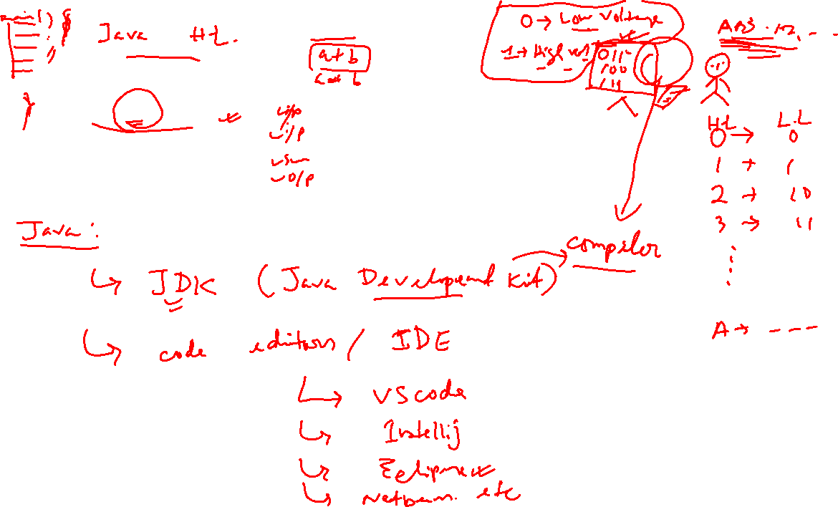
How Code works?

Slide 4
How to instal JDK and Eclipse
To check already java is installed in your computer or not
On cmd type java –version
If not then, type on browser java jdk download
Download the latest JDK 17 and install
Go to the program files in C (installation location), copy the path
In system environment variables, in systems click on path, the new then paste the copied path. Press ok
Check again whether java is installed or not by again going to cmd, type java –version
Now again go to browser, type download eclipse and download the latest version

Slide 5
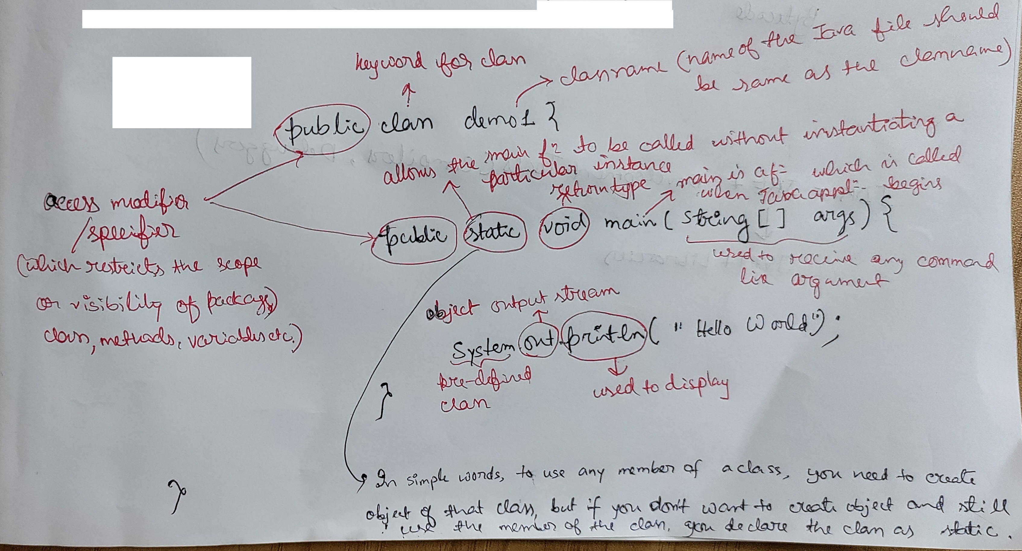

Slide 6
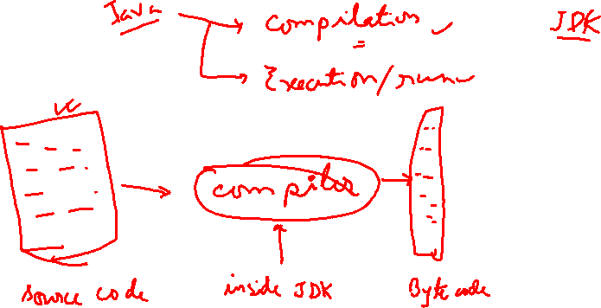
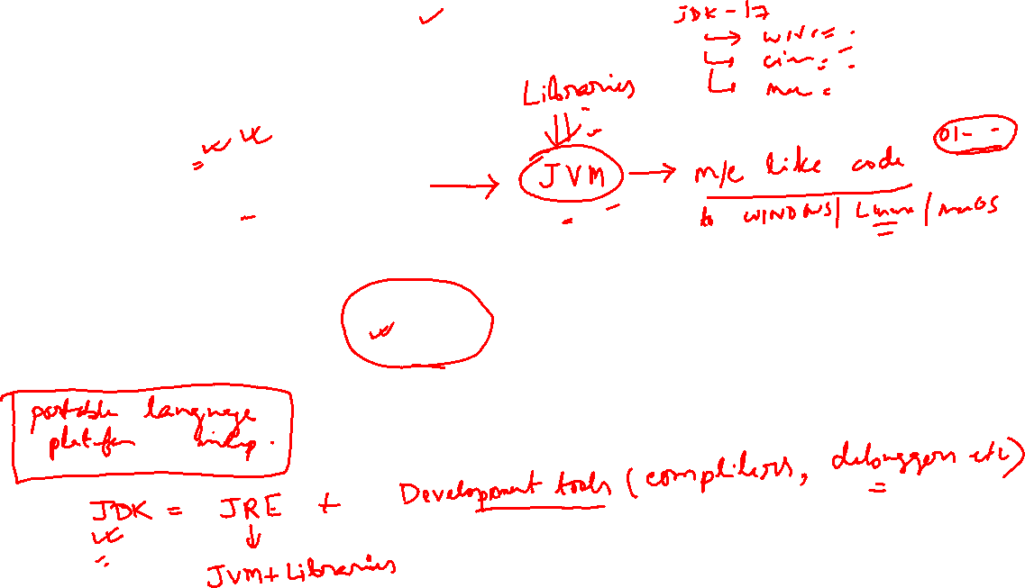

Slide 7
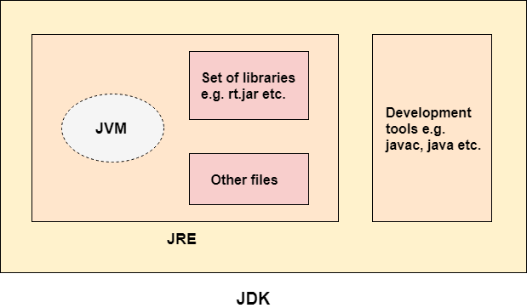
JVM (Java Virtual Machine) is an abstract machine. Loads code, Verifies code, Executes code, Provides runtime environnent where bytecode can be executed.
The Java Runtime Environment (JRE) is a set of software tools which are used for developing Java applications.
The Java Development Kit (JDK) is a software development environment which is used to develop Java applications.

Slide 8
Applications
There are many devices where Java is currently used. Some of them are as follows:
Desktop Applications such as acrobat reader, media player, antivirus, etc.
Web Applications such as irctc.co.in, javatpoint.com, etc.
Enterprise Applications such as banking applications.
Mobile
Games, etc.

Slide 9
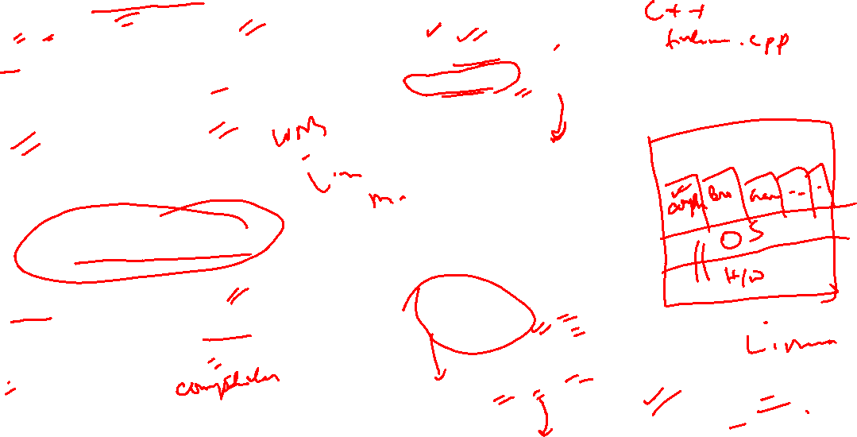
Platform Dependent
myprog.c
gcc
myprog.exe
C source code
machine code
OS/Hardware
Platform Independent
javac
myprog.class
myprog.java
bytecode
Java source code
JVM
OS/Hardware

Slide 10
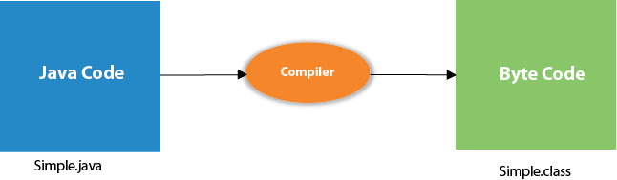

Compilation

Slide 11
Basic structure of a Java program
A Java program consists one or more of the following sections:
Documentation Section: says in simple English what task the program will solve
Package statement: organizing similar codes in package makes it easy for anyone to utilize it
Import statement: helps in reusing other’s written code; we don’t import package to use print/println, because the library for it is automatically included by compiler
Class definition: present in every Java program, it’s a logical entity which contain all the variables, methods to manipulate those variables
Main method definition: execution starts from main method to run a Java program

Slide 12
Java program: Constants, variables, data types, operators
variables:
store data values, we can keep changing the assigned values in the variables
Constants:
we cannot change the values further, assigned values is taken as fixed
Data types:
Primitives: short, char, int, float, double, Boolean etc (refer textbook)
Non-primitive: String, array, class, object, interface
Operators:
Arithmetic: +,-,*,/,%
Relational: <, <=, >=, ==, !=
Logical: &&,||,!
Assignment: =
Increment, decrement: ++,- -
Conditional: ?

Slide 13
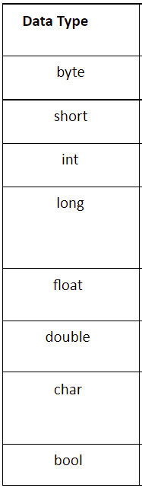
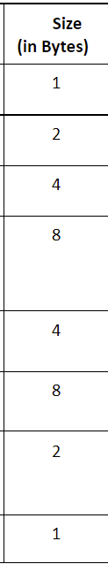
Size of Primitive data types
Size of Non-Primitive Data Types
These are of variable size & are usually declared with a ‘new’ keyword.
Eg: String name = new String(“VIT AP is a good institute”);
int [] year_wise_students= new int[4];
year_wise_students[0]=1000;
year_wise_students[1]=2000;
year_wise_students[2]=3500;
year_wise_students[3]=5500;

Slide 14
Java program: Control statements
conditional statements:
if
if else
nested if
if else if …
Switch case
break

Slide 15
Looping statements: Loop is used to do a task repeatedly whenever some condition is satisfied. A loop consists of an initialization statement, a test condition and an increment statement.
for loop syntax:
for (initialization statement; test condition; increment / decrement) {
body of the for loop
}
while loop syntax:
Initialization statement;
while(test condition) {
body of the loop;
increment / decrement;
}
do while loop syntax:
Initialization statement;
do {
body of loop;
increment / decrement;
}
while (test condition);

Slide 16
Functions: performs a particular task
Syntax of function: function name is generally written in camel case
return_type functionName(argurment1, argument2,…..)
{
body of the function;
}
Recursion: function calling itself
return_type functionName(argurment1, argument2,…..)
{
functionName(argurment1, argument2,…..);
}

Slide 17
//find the factorial of a number
//iterative version
public static void factNumber(int number)
{
int i;
int fact=1;
for(i=1;i<=number;i++)
{
fact=fact*i;
}
System.out.println(fact);
}
public static void main(String args[])
{
//factNumber(5);
}
//recursive version
public static int factorial(int n)
{
if(n==0)
return 1;
else
return(n*factorial(n-1));
}
public static void main(String args[])
{
int i;
int fact=1;
int number=5;
fact=factorial(number);
System.out.println(fact);
}

